Slide 1
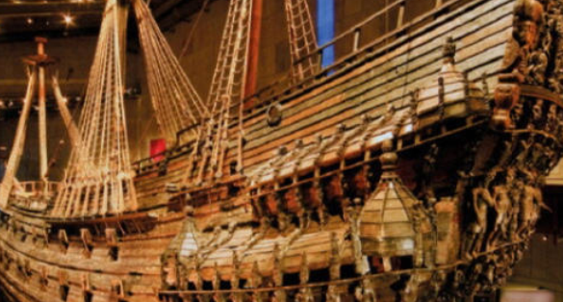
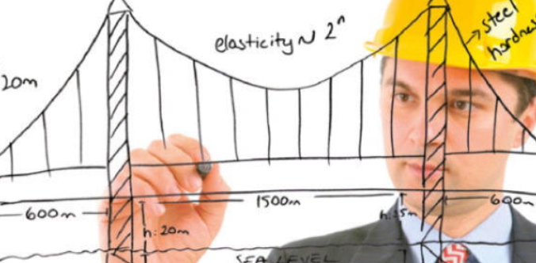
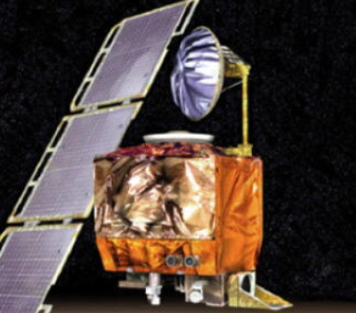

VRTC
Please search on internet about the most disastrous mistake that humans have ever made...
01 minutes
ADVANCED 1
UNIT 1

