Slide 1
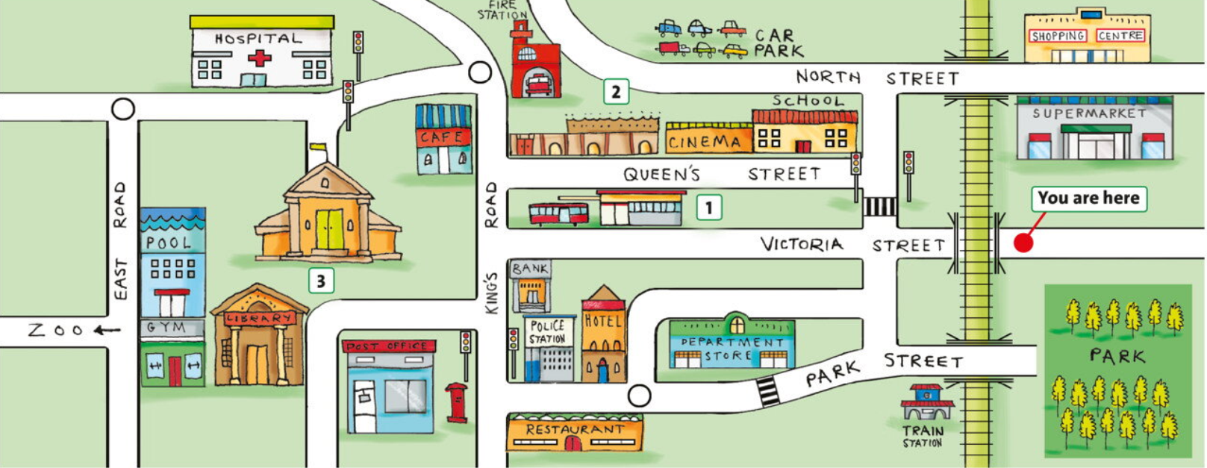
VRTC
Please your voice and give directions for three places :hospital/ fire station / post office
1 minute
elementary 3
UNIT 5G

