Slide 1
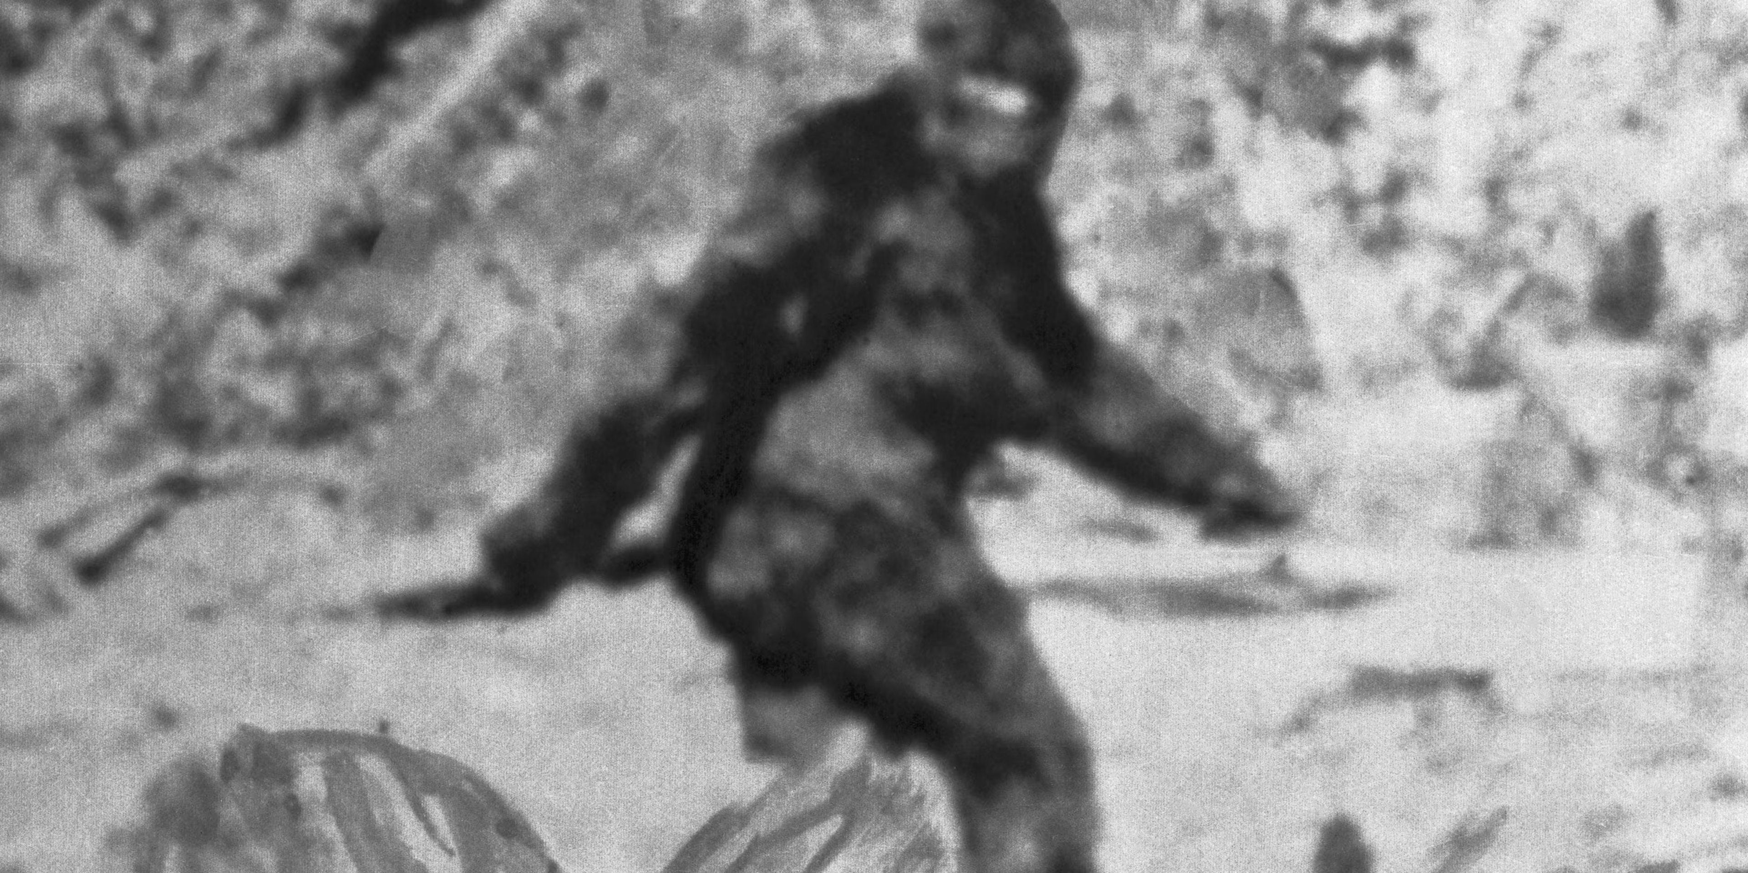
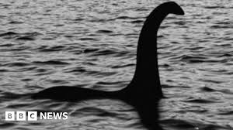
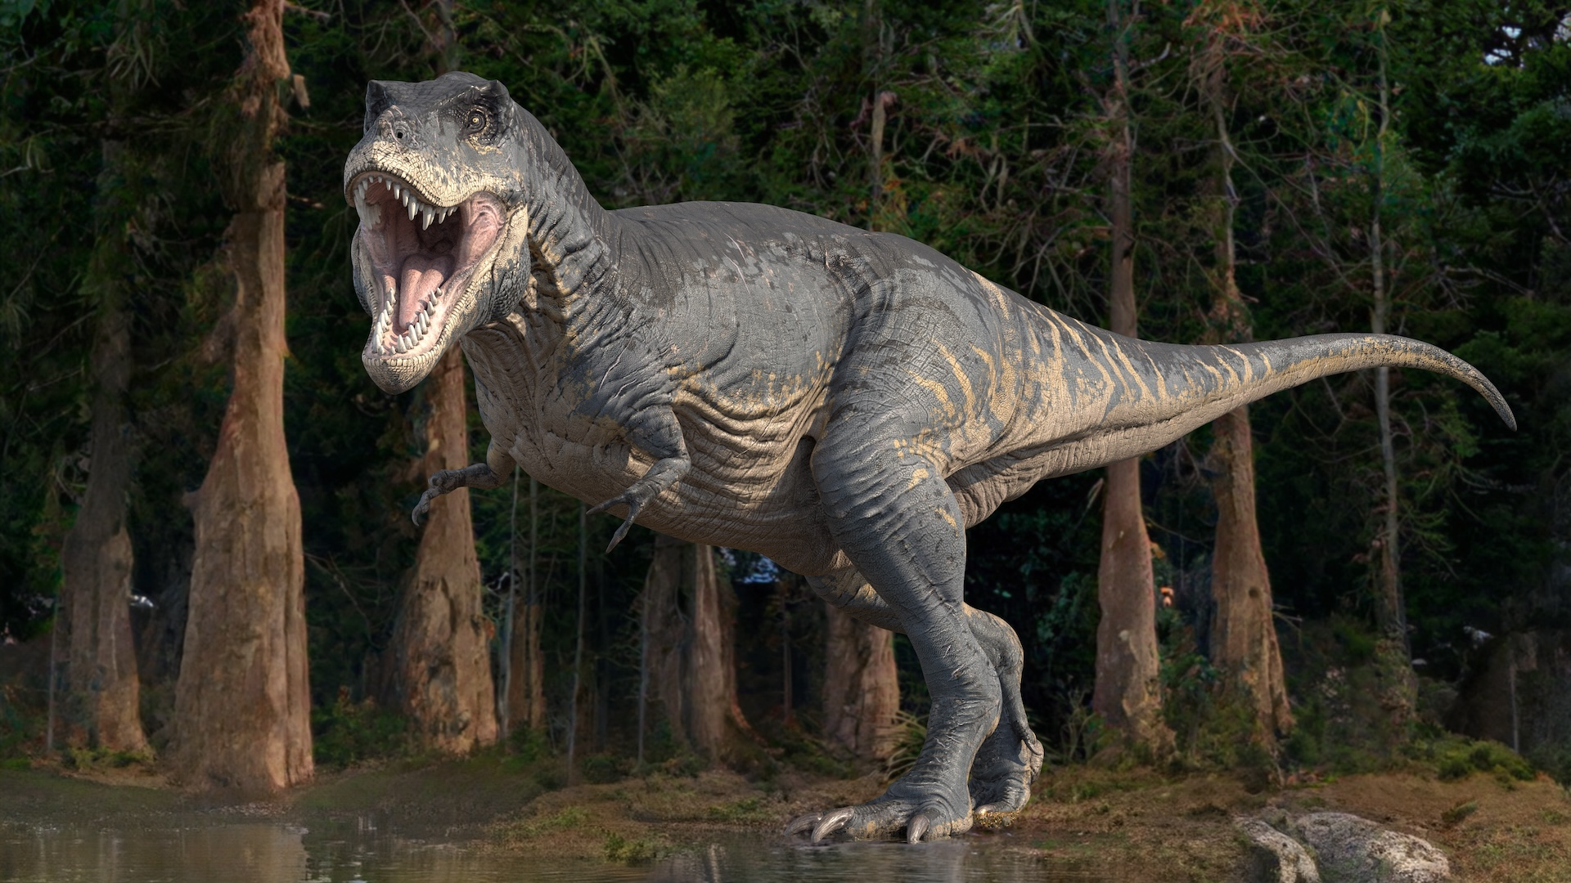

VRTC
Please describe them first then say that ...
Do you think they are real or not and give your reasons
01 minutes
Elemantary 3
UNIT 6F

