Slide 1


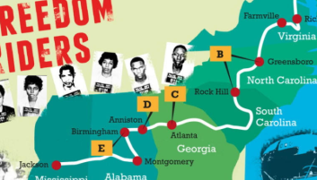


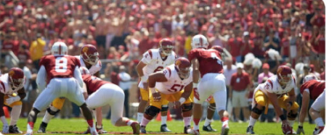




Choose three cultures and talk about them
Which one was the most interesting one?
What Suprising fact did you notice in different cultures?
What things were shocking about western culture?
What was RADA? Do you think it was a good idea?

